Slide 1
COMP 2400
Week 1 - Wednesday

Slide 2
Last time
What did we talk about last time?
Course overview
Policies
Schedule
C basics

Slide 3
Questions?

Slide 4
Project 1

Slide 5
C Basics

Slide 6
Control flow
You're already a better C programmer than you think you are!
For selection, C supports:
  if statements
  switch statements
For repetition, C supports:
  for loops
  while loops
  do-while loops
Try to implement code the way you would in Java and see what happens …

Slide 7
Conditionals
One big difference from Java is that C uses integer values for conditions
  0 (zero) is false
  Anything non-zero is true
if (6)
{
// Yep!
}
if (0)
{
// Nope!
}
if (3 < 4)
{
// Yep!
}

Slide 8
Type safety
Java is a strongly-typed language
  Types really mean something
C is much looser
double a = 3.4;
int b = 27;
a = b; // Legal in Java and C
b = a; // Illegal in Java,
// might give a warning in C

Slide 9
Precision
The C standard makes floating-point precision compiler dependent
Even so, it will usually work just like in Java
Just a reminder about the odd floating-point problems you can have:
Just like in Java, you almost always want to use double to store floating-point values, since it has more precision than float
#include <stdio.h>
int main()
{
float a = 4.0 / 3.0;
float b = a - 1;
float c = b + b + b;
float d = c - 1;
printf("%e\n", d);
return 0;
}

Slide 10
Java compilation model
You might not have thought too closely about this when using IntelliJ
When you compile Java from the command line, it looks like the following:
Doing so creates .class files
You run a .class file by invoking the JVM
> javac Hello.java
> java Hello

Slide 11
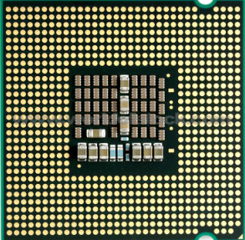
Compilation and execution for Java
class A
{
Problem p;
p.solve();
}
Compile
101110101
101011010
110010011
JVM
010101010
010100101
001110010
Execute
Java
Source
Code
Java Bytecode
Machine Code
Hardware
Platform
Independent
Platform
Dependent

Slide 12
Java compilation details
When you invoke the JVM, you specify which class you want to start with
  If many classes in the same directory have a main() method, it doesn't matter
  It starts the main() for the class you pick
Java is smart
  If you try to compile A.java, which depends on B.java and C.java, it will find those files and compile them too
.java
.class
Executes
javac
java
JVM

Slide 13
C compilation model
When you invoke gcc
  It takes a .c file, preprocesses it to resolve #include and #define directives
  The updated .c file is compiled into a .o object file
  If needed, the linker links together multiple .o files into a single executable
.c file
.c file
Linker
Pre-processor
Compiler
.o file
a.out
Execute

Slide 14
C compilation details
The C compiler is bare bones
It doesn't include any other files that you might need
You have to include and compile files in the right order
What happens if file thing1.c wants to use functions from thing2.c and thing2.c also wants to use functions from thing1.c?
  Which do you compile first?
  Header files for each will eventually be the answer

Slide 15
Basic compilation
To compile a file called hello.c into an executable called hello
To run hello, type ./hello
> gcc hello.c -o hello
> ./hello

Slide 16
Makefiles
The order of compilation matters
You have to compile all necessary files yourself to make your program work
To make these issues easier to deal with, the make utility is used
This utility uses makefiles
  Each makefile has a list of targets
  Each target is followed by a colon and a list of dependencies
  After the list of dependencies, on a new line, preceded by a tab, is the command needed to create the target from the dependencies

Slide 17
Sample makefile
Makefiles are called makefile or Makefile
all: hello
hello: hello.c
gcc -o hello hello.c
clean:
rm -f *.o hello

Slide 18
File organization
In Java, all code and data is in a class
  The class can optionally be in a package
  The name of the class must match the name of the file it's in
In C, every file is a list of functions and global variables
  That's it
  No classes, no requirements for naming anything any particular way
  To use other files, you use the #include directive which literally copies and pastes those files into the code being compiled

Slide 19
Low level language
You get operators for:
  Basic math
  Bitwise operations
  Pointer manipulation
There are no built-in operators or language features for composite data
  No way to deal with strings, arrays, lists, sets, etc.
  Instead of having language features for these things, C has a standard library that helps with some of these tasks

Slide 20
Other features
It's a small language
  You can expect to use all of it regularly
I/O is painful and library driven
  Like Java, unlike Pascal
There's no garbage collection
  In Java, create as many objects as you want with the new keyword and they will magically disappear when you no longer need them
  In C, you can allocate chunks of memory using the malloc() function, but then you have to destroy them yourself using free()
Remember: Java was designed, C was implemented

Slide 21
Why study C?
Automotive mechanic vs. automotive engineer
  Coding Java is like being a mechanic (though perhaps a fantastic one)
  You're building applications out of nice building blocks
  Coding C allows you to become an engineer
  The JVM itself was written in C and C++
Many parts of OSes, performance critical systems, virtual machines, and most embedded code is still written in C

Slide 22
C's success
It's close to what's actually happening in the machine
  Fast and predictable
It's sort of like Latin
  Informs English, French, Italian, Spanish, etc.
  The language of classical literature, church history, scientific nomenclature
You can argue about which language is best; C does not care, because it still rules the world.
Dennis Brylow

Slide 23
Declaration syntax standards
You couldn't declare a variable in the header of a for loop in C89
The following line of code used to cause a compiler error:
The version of gcc in this lab uses the C99 standard by default, which allows it
For fully compliant C89 compilers, you actually have to declare all of your variables at the top of a block
These older versions shouldn't be an issue, but you never know when you might have to use an older compiler for an older system
for(int i = 0; i < 100; ++i)
{
printf("%d ", i);
}

Slide 24
C standards
Most programming languages have multiple versions
  C is no exception
The original, unstandardized version of the language used at Bell Labs from 1969 onward is sometimes called K&R C
  It's similar to what we use now but allowed weird function definition syntax and didn't have function prototypes
Most of what we talk about is ANSI C89 which is virtually identical to ISO C90
We'll use a few features from C99
  Declaring variables anywhere (including in for-loop headers)
  Single-line comments (originally, only /* comment */ was allowed)
  stdbool.h
  I encourage you not to use variable-length arrays, since they mostly cause trouble
There's even a C11 (2011) standard, but it doesn't add anything we care about

Slide 25
History of Unix, Linux, and C

Slide 26
What does UNIX even mean?
It was originally called Unics (UNiplexed Information and Computing Service)
  A pun on another OS, Multics (MULTiplexed Information and Computer Services)
  After it starting supporting multiple simultaneous users, it was renamed Unix
So, it doesn't stand for anything anymore (sort of like CERN)

Slide 27
What is Unix?
It's a standard for operating systems based on a long, complex history with many companies and innovators
The Open Group has the trademark on the term "UNIX," and you're only allowed to call your OS Unix if it meets their Single UNIX Specification
Linux and FreeBSD and other free implementations of Unix do not meet this specification

Slide 28
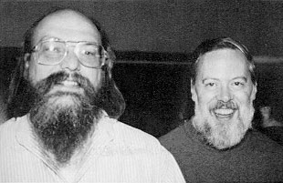
Development
Ken Thompson started working on Unix in 1969 at Bell Laboratories, a division of AT&T
It was written in assembly language for the PDP-7 and PDP-11 minicomputers
  Made by Digital Equipment Corporation (DEC), a giant of that era that was bought by Compaq (which was bought by HP)
Meanwhile, Dennis Ritchie developed the C programming language
It was mature enough in 1973 that most of Unix could be implemented in it
This connection has established C as the pre-eminent systems programming language

Slide 29
Distribution
Unix was originally only used within AT&T
Because AT&T has a monopoly on telephone service, they weren't allowed to sell software
They started giving Unix to universities for a distribution fee
While spending a year at Berkeley, Thompson worked on BSD (Berkeley Software Distribution), a version of Unix that was widely used in academia
AT&T's monopoly broke up, allowing them to sell Unix, eventually leading to the famous System V Unix in 1983

Slide 30
Ports
System V was used as the basis of Unix systems on lots of different kinds of hardware
  Sun: SunOS and Solaris
  DEC: Ultrix and OSF/1 (which became HP Tru64 UNIX)
  IBM: AIX
  HP: HP-UX,
  Apple: NeXTStep, A/UX
  Intel: XENIX

Slide 31
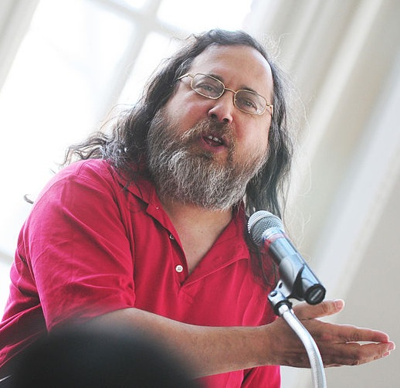
GNU
Richard Stallman (RMS) is the father of open source software
He started in the GNU (GNU's Not Unix) project in 1984
  This created the GPL (GNU Public License)
The focus is on the ability to run, copy, and improve software
Lots of useful programming tools that have been incorporated into Linux came out of GNU:
  emacs
  gcc
  bash
  The glibc

Slide 32

Linux
Linus Torvalds started working in 1991 to make a Unix kernel to run on an Intel 386
He put Linus's Unix (Linux) under the GNU GPL
The BSD distributions also gave rise to free BSD implementations (notably FreeBSD), but their usage is much less widespread than Linux
Linux kernel version numbers are x.y.z where x is a major version, y is a minor version, and z is a minor revision
  Current stable release is 6.12.9

Slide 33
Distributions
Linux is just the kernel, the part of the OS that manages resources and schedules processes
To put Linux on your computer, you need a distribution
A distribution includes a whole OS:
  The kernel (of course)
  Windowing system
    GNOME
    KDE
  Package management
    dpkg
    APT
    pacman
    rpm
    YUM
  Tools and utilities
  Hardware drivers
Distributions can be big or small and are often customized for a particular purpose
  Desktop
  Server
  Phone
  Embedded software

Slide 34
Popular distributions
Family | Distribution | Notes
Debian | Debian | Stable but slow release cycle
 | Ubuntu | Managed by for-profit company Canonical Has long-term-support (LTS) versions
 | Mint | Based on Ubuntu
 | MX | Good driver support
Arch | Arch | Rolling release and highly customizable
Gentoo | Gentoo | Very customizable but hard for beginners to set up
Slackware | Slackware | Stable and been around forever
Red Hat | Red Hat Enterprise | For-profit, with commercial support
 | Fedora | Open-source version of Red Hat
SUSE | openSUSE | Good installer, weak performance
Details from https://distrowatch.com/

Slide 35
Upcoming

Slide 36
Next time…
More C basics
Math library
Data representation

Slide 37
Reminders
Lab 1 is tomorrow
Keep reading K&R Chapter 1

